Slide 1
Rapid Assessment Team (RAT) Field Reporting Tools
Bill DeVoe, Maine Department of Marine Resources
Area committee meeting December 5th, 2019

Slide 2
Role of Rapid Assessment Teams
RATs provide first looks from the field during spill response, identifying targets for response and affected areas.
Not as much detail/quantification as Shoreline Cleanup and Assessment Technique (SCAT).
Field reports are submitted to Situation Unit Leader (SITL) via ICS-209-CG Incident Status Summary .

Slide 3
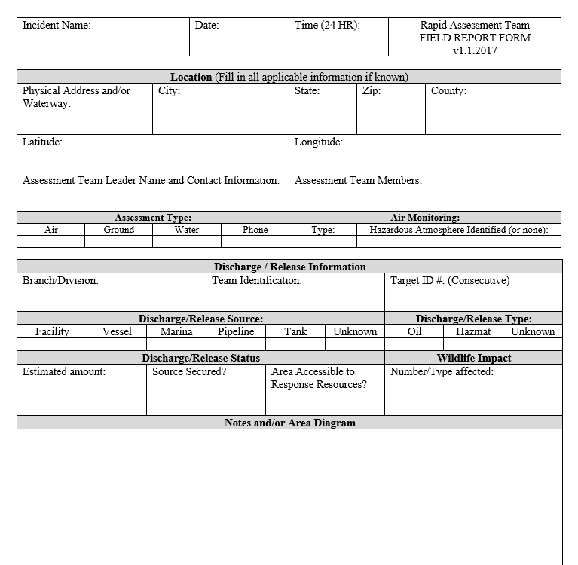
Existing MS Word Form -

Slide 4
Survey123/ArcGIS Online
ArcGIS Online is available to all Maine state agencies
Used to host/view/collect tabular and spatial data, maps, web apps
Survey123 is a web/mobile form builder that is part of ArcGIS Online
A single license can collect form data from an unlimited number of “public” users
Runs in browser or offline if Survey123 app is installed
Survey123 has previously been used by the EPA/USCG for documenting response targets after Hurricane Irma

Slide 5
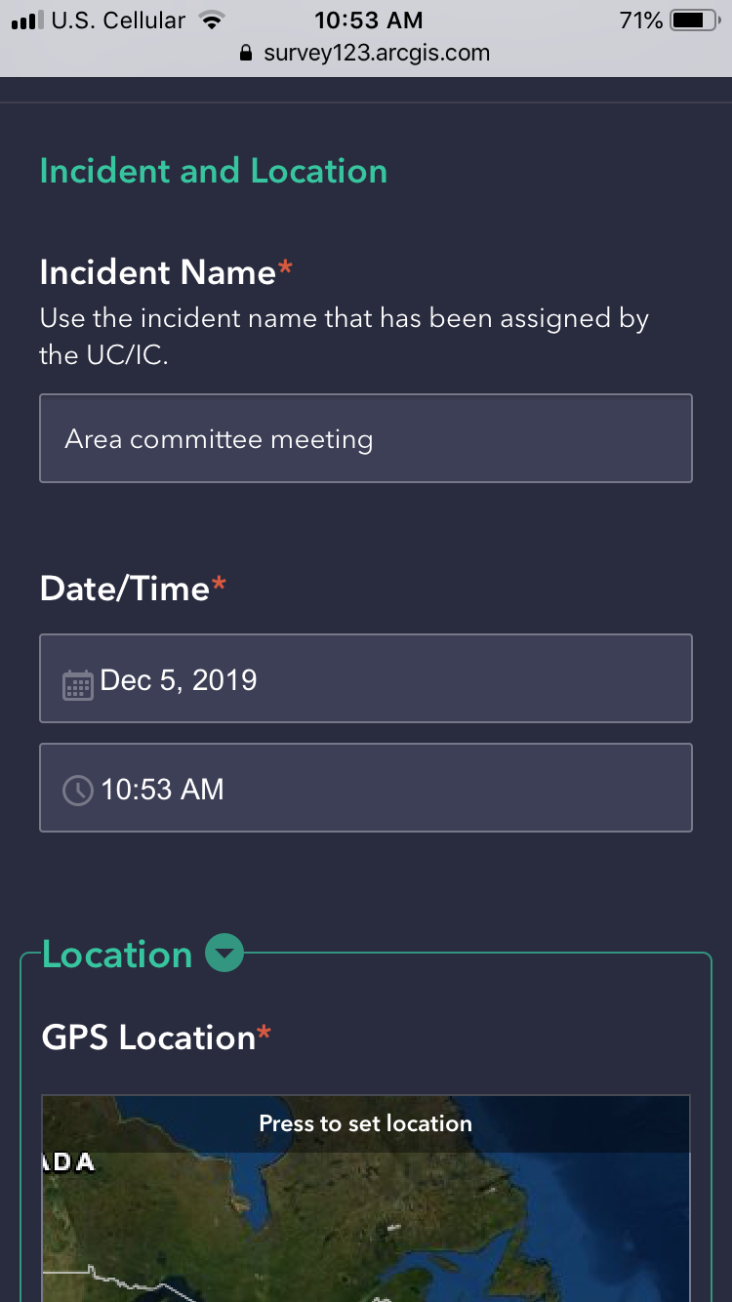
Survey123 Form

Slide 6
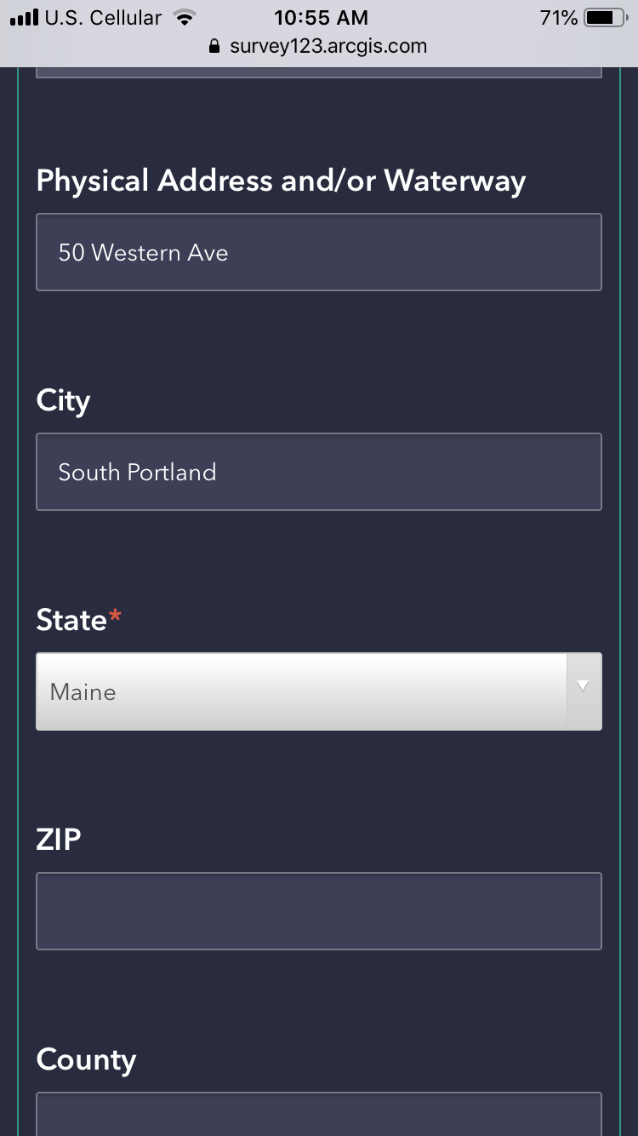
Survey123 Form

Slide 7
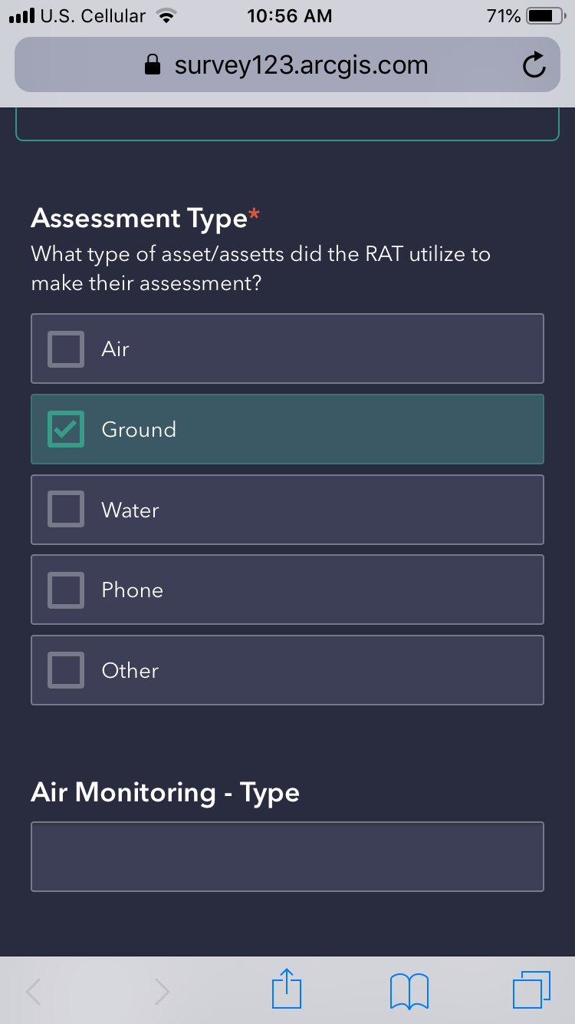
Survey123 Form

Slide 8
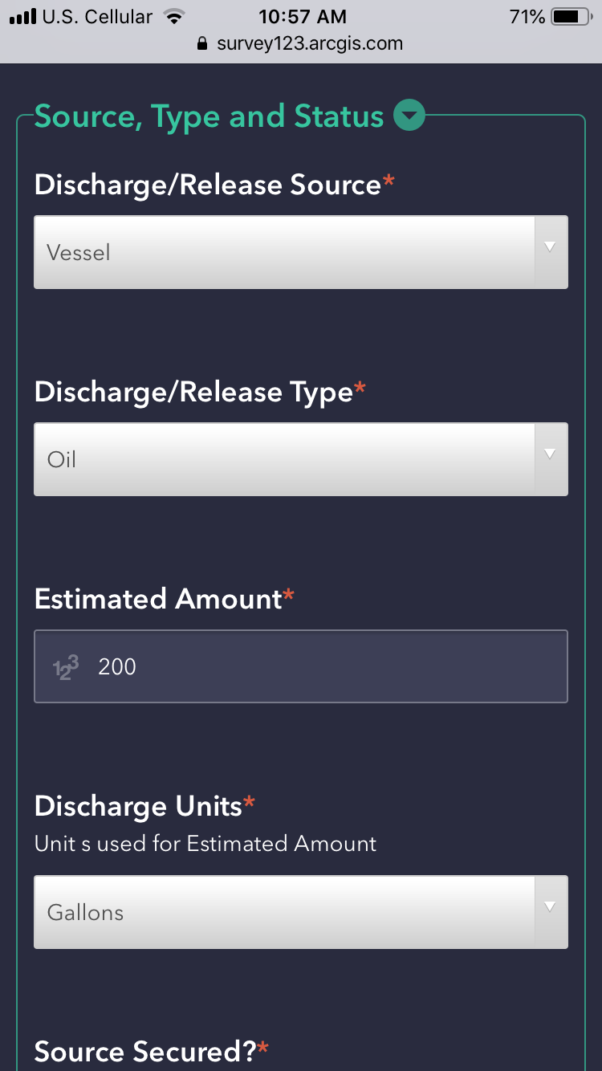
Survey123 Form

Slide 9
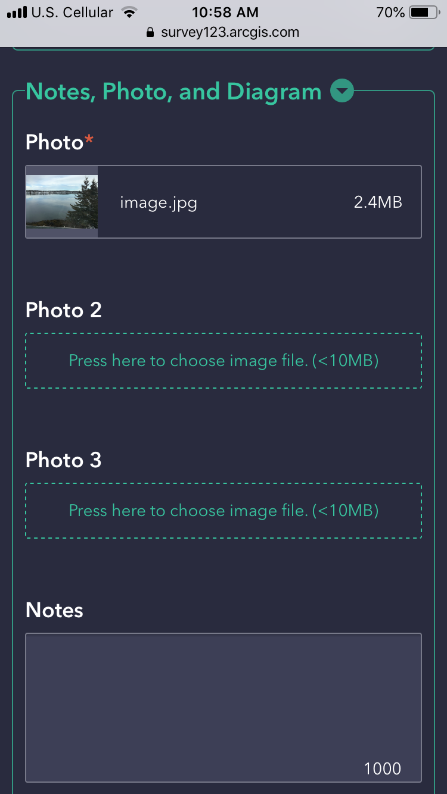
Survey123 Form

Slide 10
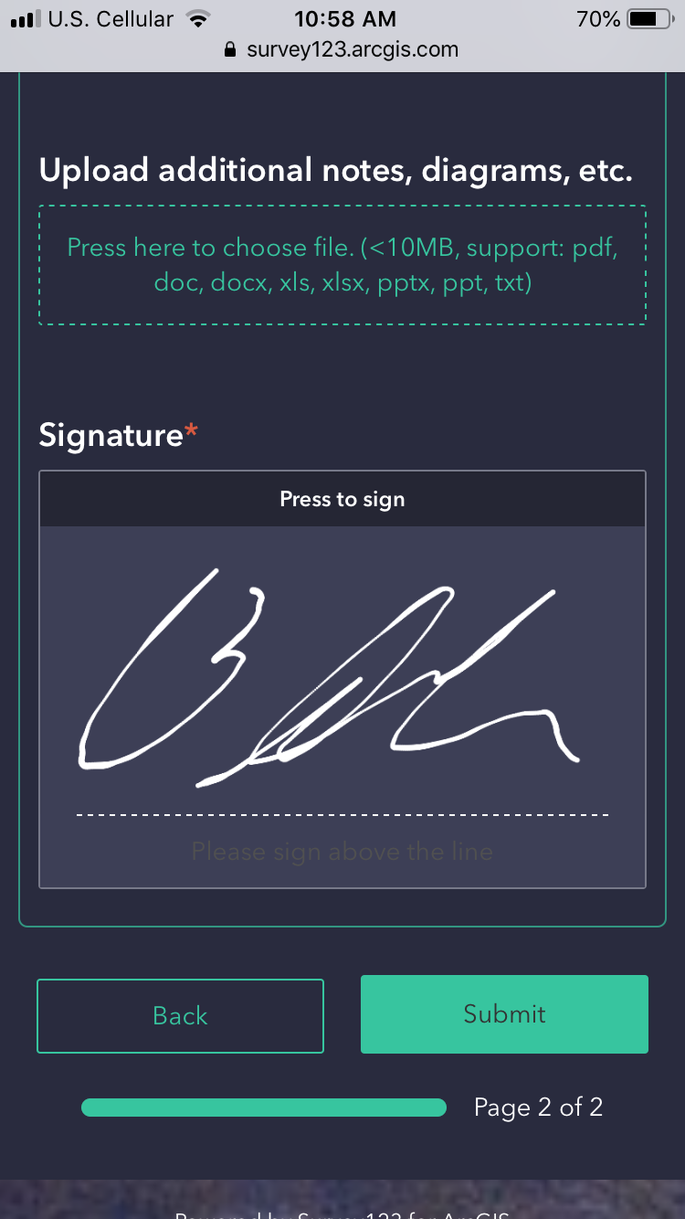
Survey123 Form

Slide 11
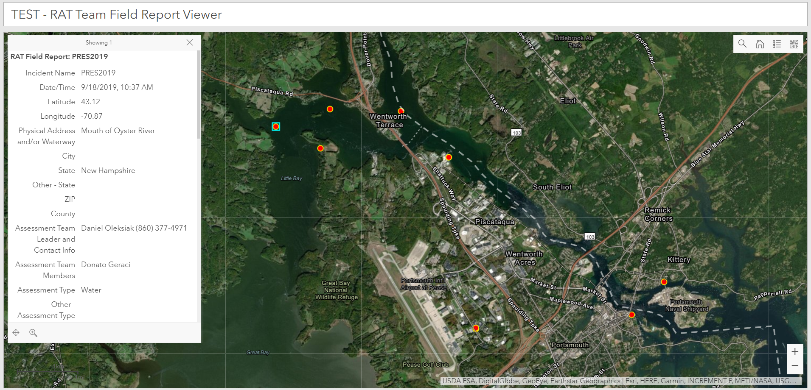
Web Map SITL View

Slide 12
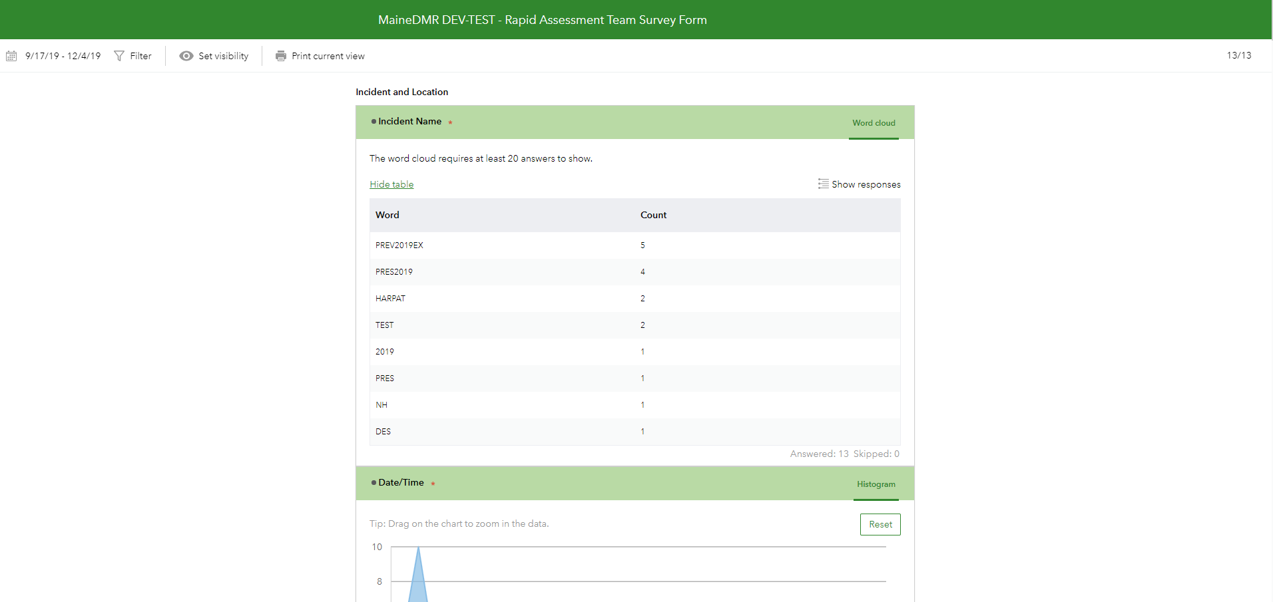
Record View

Slide 13
Piscataqua River Exercise 2019
Survey123 used by RAT teams during exercise
Reports viewed on web map in real-time
Results transcribed into ICS-209-CG

Slide 14
Future work
Incorporate Survey123 guidance into Area Contingency Plan
Add drop-downs to form, customize form for different potential response scenarios
Use Microsoft Flow to trigger emails/push notifications as reports are submitted
Possibility of ArcGIS Online subscription for USCG
Better use of web map/dashboards in Common Operating Picture.

Slide 15
Special Thanks
Kyle Goetz, ENS USCG for assistance in testing/deploying form
PRES 2019 RAT Team Members
Area Contingency Plan Update Group members

